Slide 1

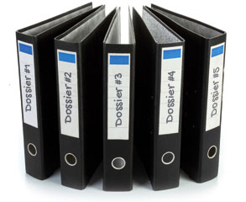
DOSSIER PREPARATION WORKSHOP
OFFICE OF FACULTY AFFAIRS
KECK SCHOOL OF MEDICINE OF USC

Slide 2
Meet the APT team
Ruth Wood: riw@usc.edu
Natalie Aguiar: Natalie.Aguiar@med.usc.edu
Jen Nelson: Jen.Nelson@med.usc.edu
Forms are available at
https://keck2.usc.edu/faculty-affairs/administrative-procedures/forms-and-templates/
And, yes, we are working on revising the website…

Slide 3
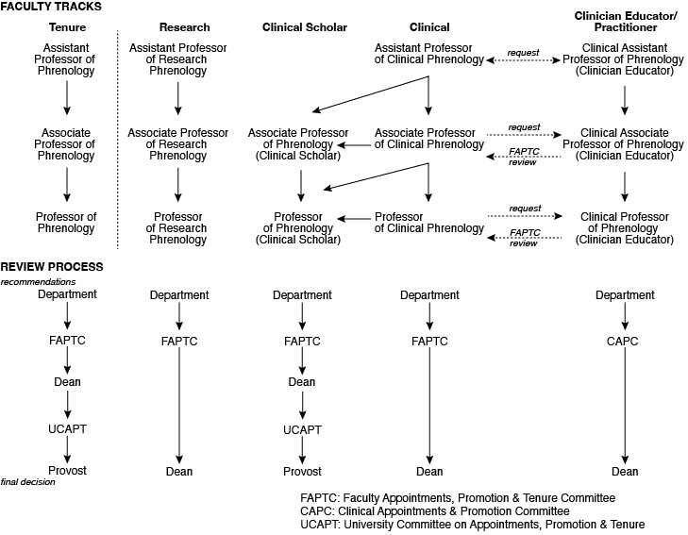

Summary of different tracks
October 1 FAPTC Deadline
September 1 Receive completed dossier at Department
July 1 Request letters
_ arms-length letters for tenure decision
_ arms-length letters for promotion to professor
June 1 Receive completed candidate portion
CV in USC format
Personal statement: research, teaching, service
Teaching record:
list of lectures & classes
teaching evaluations
list of grad students & post-docs mentored
Service record
Notes:
Dossiers for promotion in different tracks are reviewed by different committees, as shown above. FAPTC and CAP-C are Keck School committees (FAPTC is the Faculty Appointments, Promotion & Tenure Committee; CAP-C is the Committee on Appointments & Promotion- Clinical). UCAPT is the University Committee on Appointments, Promotion & Tenure. There are 7 UCAPT panels. Most Keck School faculty will be reviewed by the Life Sciences Panel (for most basic scientists) or the Clinical Sciences Panel (for most clinician-scientists). Decisions for tenure or Clinical Scholar are decided by the Provost. Those for promotion on the clinical or clinician-educator/practitioner tracks are decided by the Dean of the Keck School.

Slide 4
Summary of different tracks
October 1 FAPTC Deadline
September 1 Receive completed dossier at Department
July 1 Request letters
_ arms-length letters for tenure decision
_ arms-length letters for promotion to professor
June 1 Receive completed candidate portion
CV in USC format
Personal statement: research, teaching, service
Teaching record:
list of lectures & classes
teaching evaluations
list of grad students & post-docs mentored
Service record
Notes:
Dossiers for promotion in different tracks are reviewed by different committees, as shown above. FAPTC and CAP-C are Keck School committees (FAPTC is the Faculty Appointments, Promotion & Tenure Committee; CAP-C is the Committee on Appointments & Promotion- Clinical). UCAPT is the University Committee on Appointments, Promotion & Tenure. There are 7 UCAPT panels. Most Keck School faculty will be reviewed by the Life Sciences Panel (for most basic scientists) or the Clinical Sciences Panel (for most clinician-scientists). Decisions for tenure or Clinical Scholar are decided by the Provost. Those for promotion on the clinical or clinician-educator/practitioner tracks are decided by the Dean of the Keck School.

Slide 5

Identify the primary area of excellence
(1-2 sentences):
• scholarship (tenure-track, research)
• teaching
• service
• patient care (clinician-educator)
Notes:
Individuals on the clinical track have more flexibility to choose their primary area of excellence.

Slide 6



What’s the right track?
Teaching &
Who? clinical (%)
Research MD or PhD <10%
Tenure MD or PhD ~20%
Clinical Scholar MD or (PhD)
Clinical MD or PhD
Clinician-Educator MD or PhD >85%
(varies)
_

Slide 7


Tenure/Clinical Scholar:
What happens to the dossier?
Candidate Assembles preliminary materials
APT Coord Completes dossier, including letters from referees
Dept & Chair Reviews dossier, makes recommendation to Dean
FAPTC & Dean Reviews dossier, makes recommendation to Provost
UCAPT Reviews dossier, makes recommendation to Provost
Provost Reviews dossier, makes decision

Slide 8
Tenure Timeline: why does it take so long?
June 30 Mandatory decision date
Spring UCAPT review:
Dossier reviewed in Vice Provost's Office
Dossier put on UCAPT agenda, distributed to UCAPT panel
Panel meets to make recommendation to Provost
Provost makes decision on behalf of President
Fall FAPTC review:
Dossier reviewed in Office of Faculty Affairs
Dossier put on FAPTC agenda, distributed to FAPTC panel
Panel meets to make recommendation to Dean
Dean prepares written assessment and recommendation
Dossier delivered to Vice Provost's Office
October 1 Deadline for Faculty Affairs to receive completed dossier

Slide 9
Tenure Timeline: assembling the dossier
October 1 Deadline for Faculty Affairs to receive completed dossier
September 1 Dossier assembled and distributed to Dept APT Committee
Dept APT Committee reviews and discusses dossier
Chair writes assessment letter
Dossier delivered to Faculty Affairs
July 1 Review preliminary dossier
Request letters
Review letters: are they arms-length?
did they answer all questions? if not, follow up by email.
June 1 Receive preliminary materials from candidate
Be Prepared
• Keep track of appointments and promotions for your departmental faculty.
• Know the mandatory decision dates for assistant professors on the tenure track.
• Alert faculty of upcoming deadlines.

Slide 10
TT/CS: Timeline for Promotion to Professor
July 1 Deadline for Faculty Affairs to receive completed dossier
June 1 Dossier assembled
April 1 Request letters
March 1 Receive preliminary materials from candidate
There is no mandatory decision date.
Why is there a deadline?
Tenure dossiers do have deadlines, and they take priority.
Dossiers for promotion to professor that are submitted after the July 1 deadline may not be considered until the following year.

Slide 11
Clinical/Research:
What happens to the dossier?
Candidate Assembles preliminary materials
APT Coord Completes dossier, including letters from referees
Dept & Chair Reviews dossier, makes recommendation to Dean
FAPTC Reviews dossier, makes recommendation to Dean
Dean Reviews dossier, makes decision

Slide 12
Clinician Educator/Practitioner:
What happens to the dossier?
Candidate Assembles preliminary materials
APT Coord Prepares dossier, submits contact emails to Faculty Affairs
Faculty Affairs Requests survey from contacts
Dept & Chair Reviews dossier, makes recommendation to Dean
CAPC Reviews dossier, makes recommendation to Dean
Dean Reviews dossier, makes decision

Slide 13
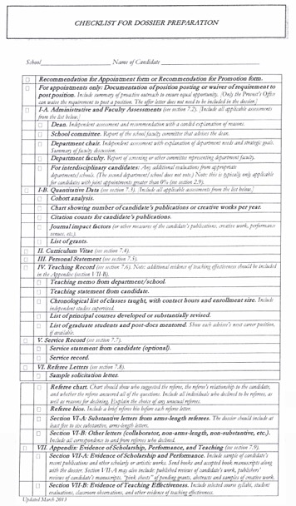
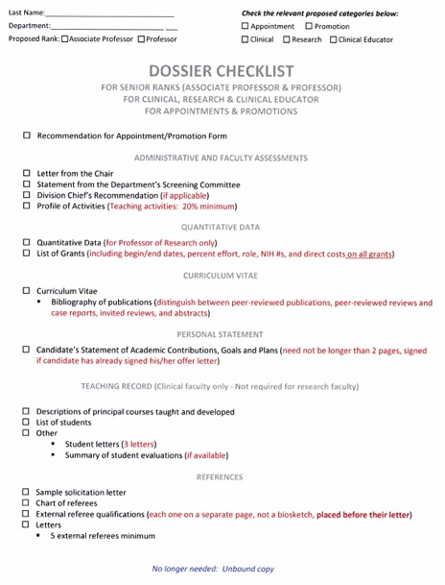
DOSSIER CHECKLISTS
tenure-track/clinical scholar clinical/research track

Slide 14
DOSSIER CHECKLIST: Clinician-educator/Practitioner

Slide 15
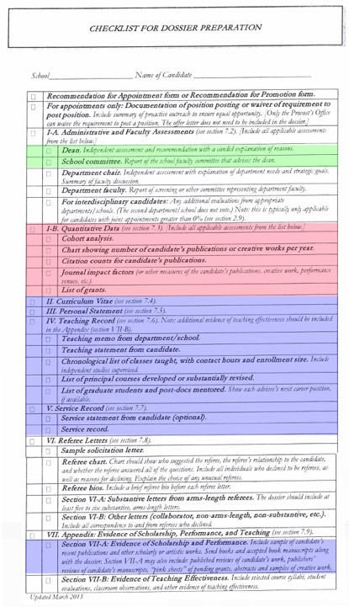
Who does What?
Office of Faculty Affairs
Candidate
Only for tenure-track/
clinical scholar
Remember to check for joint appointments.
(requires a letter or signature from 2nd department)

Slide 16
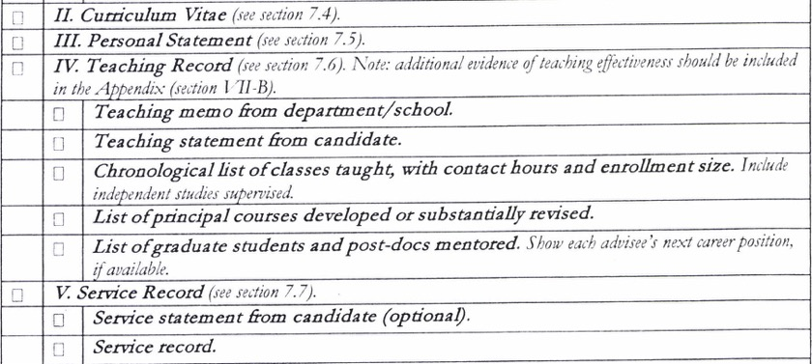
Dossier preparation: the candidate’s portion
Use forms available on Faculty Affairs website
And, yes, we are working on revising the website…

Slide 17
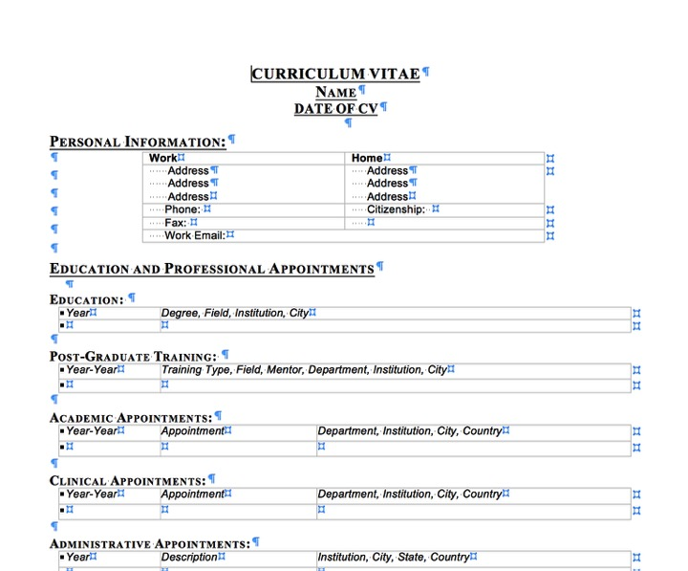

The USC CV format provides consistency
Delete sections that don’t apply
Delete subheadings (in italics)

Slide 18
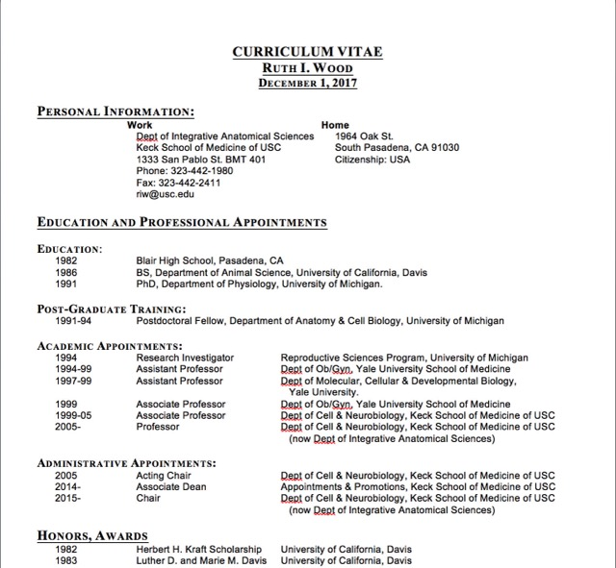
The cv should look like the template…
(even if you don’t actually use the template)

Slide 19
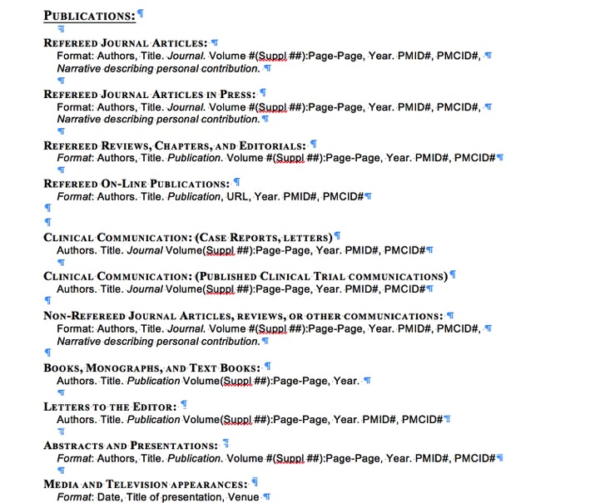
Journal article vs. Case report vs. Review?
Verify on PubMed

Slide 20
Narrative? Trainees*?

Slide 21


THE PERSONAL STATEMENT
EXPLAINS YOUR CAREER
• Identifies the ‘big’ question/unmet need.
• Articulates a theme to your accomplishments.
• Highlights your contributions to the field.
• Explains any gaps or questions in your cv.
from this to this
Notes:
When you go on vacation, you may take hundreds of photos. When you come home from vacation, you choose the best photos, and organize them to share with friends and family. Using this analogy, your CV is the entire photo collection; your personal statement is the photo album.

Slide 22


Who reads the personal statement?
• External reviewers. A well-written statement
helps them write a strong letter.
• Review committees for the department and
the Keck School. A well-written statement
explains what you do to a broad audience.
• UCAPT & Provost (for tenure-track & clinical
scholars). See above.
Notes:
Your department chair writes a letter recommending you for promotion. For tenure-track and clinical scholar candidates, the Dean also writes a letter. A well-written personal statement helps them, too.

Slide 23

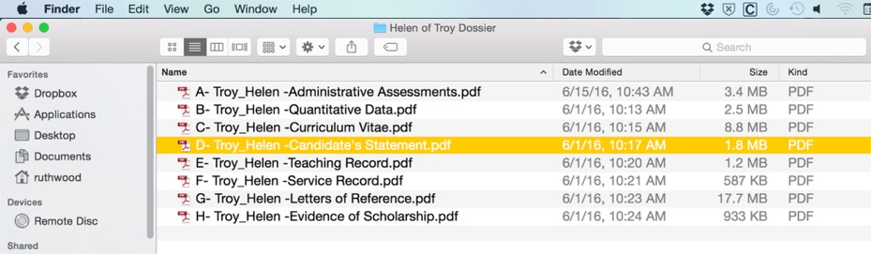
Personal statement
Do’s & Don’t’s
1. DON’T REPEAT YOUR CV.
Chances are, reviewers have already read it.
Notes:
This is what your dossier looks when the review committee receives it. There’s no requirement for reviewers to read the sections in order, but many do (I do). If so, reviewers will have just reviewed your cv before they read your personal statement. For this reason, your personal statement should explain your cv, but not repeat it.

Slide 24
Personal statement
Do’s & Don’t’s
2. CONSIDER THE READER
• Do write for a broad audience in biological science.
• Don’t write for the specialists in your field.
imagine you are explaining your work to a
colleague from another department
Notes:
Review committees include basic scientists & clinicians. Make sure that you explain specialized terms so that all reviewers understand your work. As a guideline, consider the background for a grant application or a wikipedia article. External reviewers should be familiar with your work, but they wont mind reading a well-written background.

Slide 25
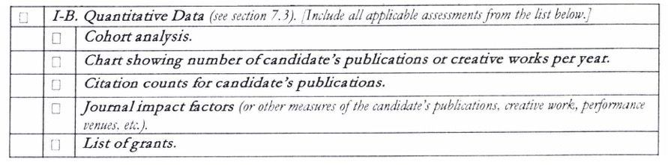
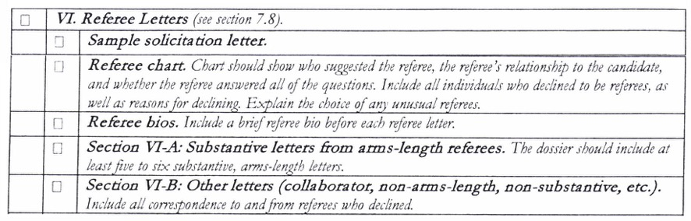
Dossier preparation: the hard parts
TT/CS:
TT/CS & Clinical:

Slide 26
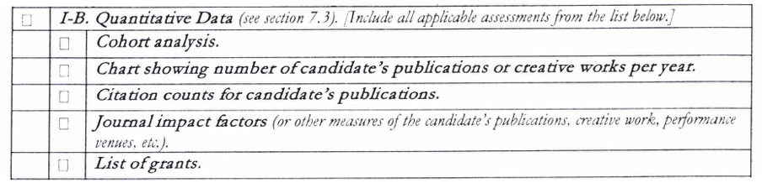
TT/CS: Quantitative Analysis
No cohort analysis for clinical scholars.
Use Web of Science, don’t use Google Scholar.
See details at back of this ppt.

Slide 27
Dossier preparation: Referee Letters
TT/CS & Clinical:

Slide 28
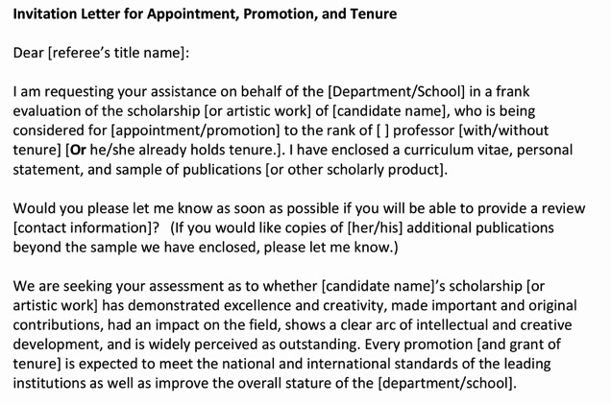
TT/CS & Clinical: VI. Referee Letters
Use the solicitation letter
Include a copy in the dossier

Slide 29
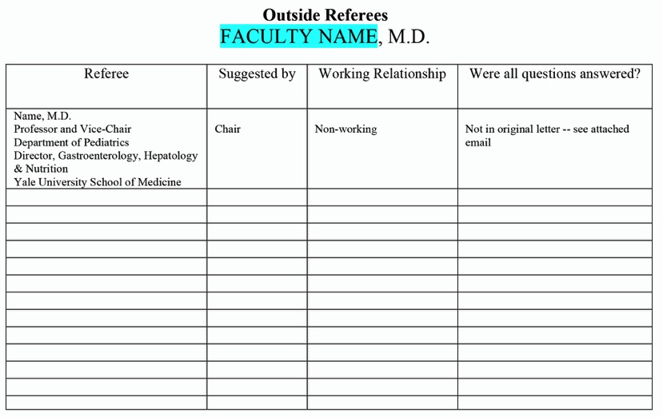
TT/CS & Clinical: VI. Referee Letters
List in order:
Arms-length letters, suggested by chair
Non-arms-length letters, may be suggested by candidate.
Individuals who declined to be referees. Attach correspondence, if any.

Slide 30
TT/CS & Clinical: VI. Referee Letters
Letters:
TT/CS: 5 arms-length letters required (solicit 10-12 letters)
Pro tips: check for joint publications before you send request
referee response is better if the email is from the chair
Clinical: 5 letters required.
Number of arms-length letters varies with area of excellence.
What is an arms-length referee?
No joint authorship on publications, unless they are part of a large group:
‘Alzheimer’s Disease Neuroimaging Initiative’
No substantial participation together on grants
No overlap in training or previous appointments
No substantial personal connection
Do contact potential referees by email, not by phone.
Do follow up with referee by email (1x only), if no response
Do make sure the referee chart accurately reflects referee responses.
Don’t suggest potential wording for referees to use in evaluation of candidate.
Don’t allow candidate to contact potential referees.
Don't delay! If letters are > 1 year old, you must contact referee again.

Slide 31
DOSSIER CHECKLIST: Clinician-educator/Practitioner

Slide 32
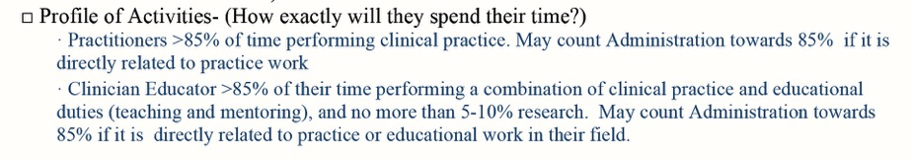
Clinician Educator/Practitioner:
Assembling the dossier

Slide 33
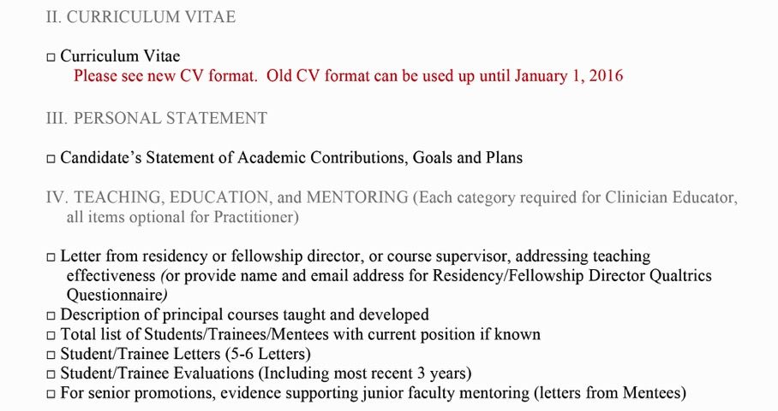
Clinician Educator/Practitioner:
Candidate’s portion

Slide 34
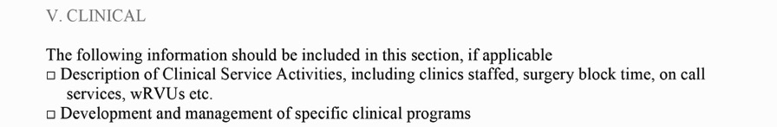
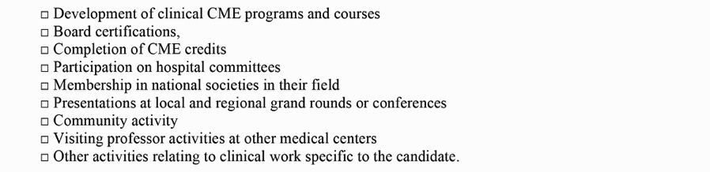
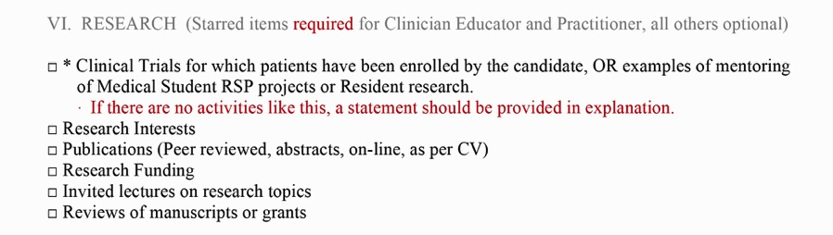
Clinician Educator/Practitioner:
Candidate’s portion

Slide 35
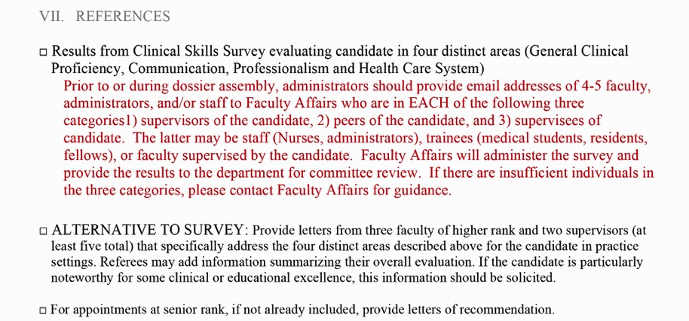
Clinician Educator/Practitioner:
Reference Letters

Slide 36
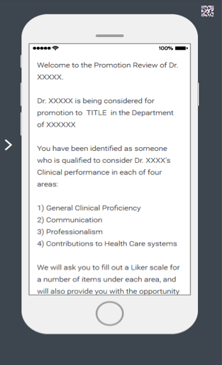
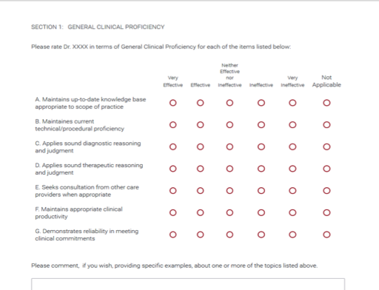
Clinician Educator/Practitioner:
on-line survey of clinical effectiveness
Qualtrics survey using Likert scale
Anonymous: Dept submits contacts to Faculty Affairs. Faculty Affairs administers survey.
Narrative evaluation is also part of on-line process.

Slide 37
Questions?

Slide 38
Detailed information on preparing
I-B. Quantitative Analysis

Slide 39
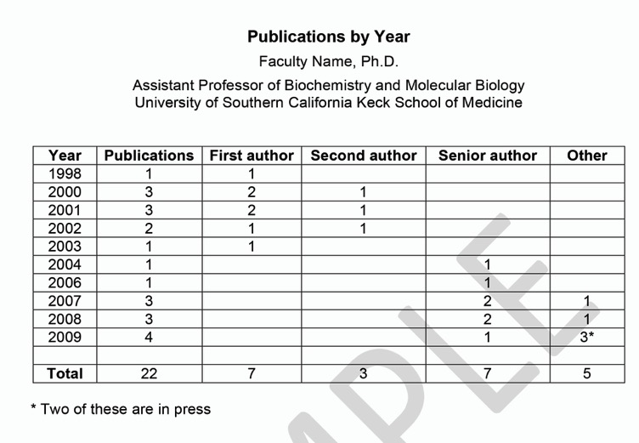
TT/CS: I-B. Quantitative Analysis
from candidate's cv

Slide 40
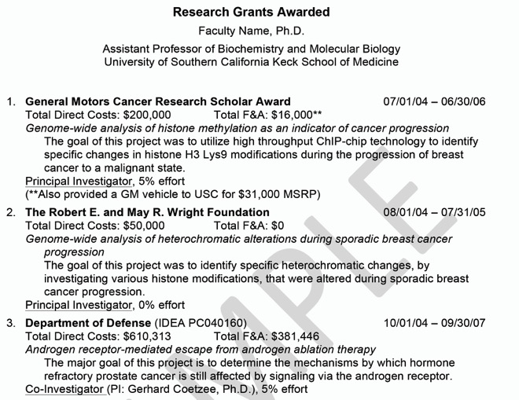
TT/CS: I-B. Quantitative Analysis
from candidate's cv

Slide 41
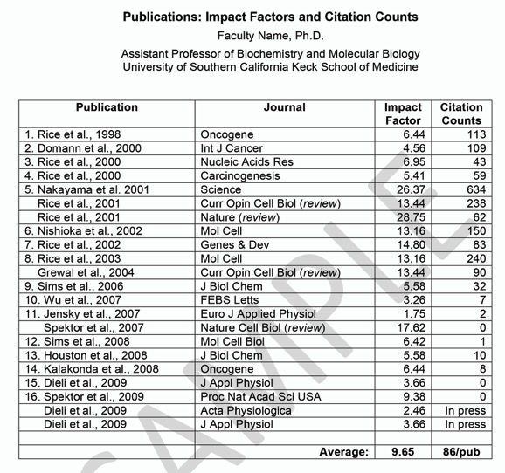
TT/CS: I-B. Quantitative Analysis

Slide 42
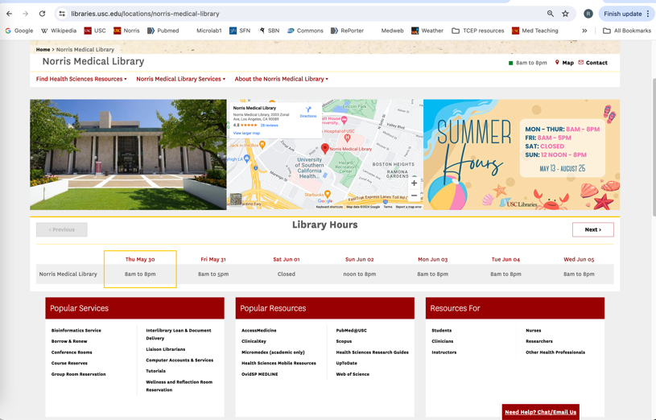
TT/CS: I-B. Quantitative Analysis
Don’t use Google Scholar.

Slide 43
TT/CS: I-B. Quantitative Analysis

Slide 44
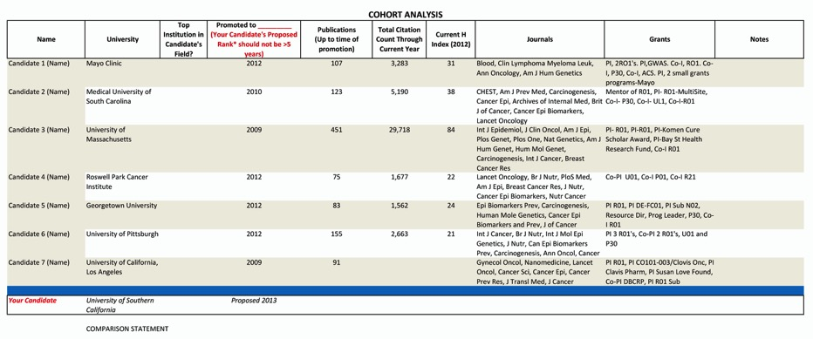
TT/CS: I-B. Quantitative Analysis
(tenure-track/clinical scholar only)
Dept chair & candidate can identify cohort. Request cv or:
Web of Knowledge Citation Report
(document types: article, review)
NIH RePORTER for grants

