Slide 1
KSOM Research Administrators Forum May 17, 2025
AGENDA
Professional Service Agreements (Katie)
Grant Close-out (Janet)
Personal Conflict of Interest and Grants (Janet)
Grant deadlines and University closure July 4 & 5

Slide 2
Professional Service Agreements

Slide 3
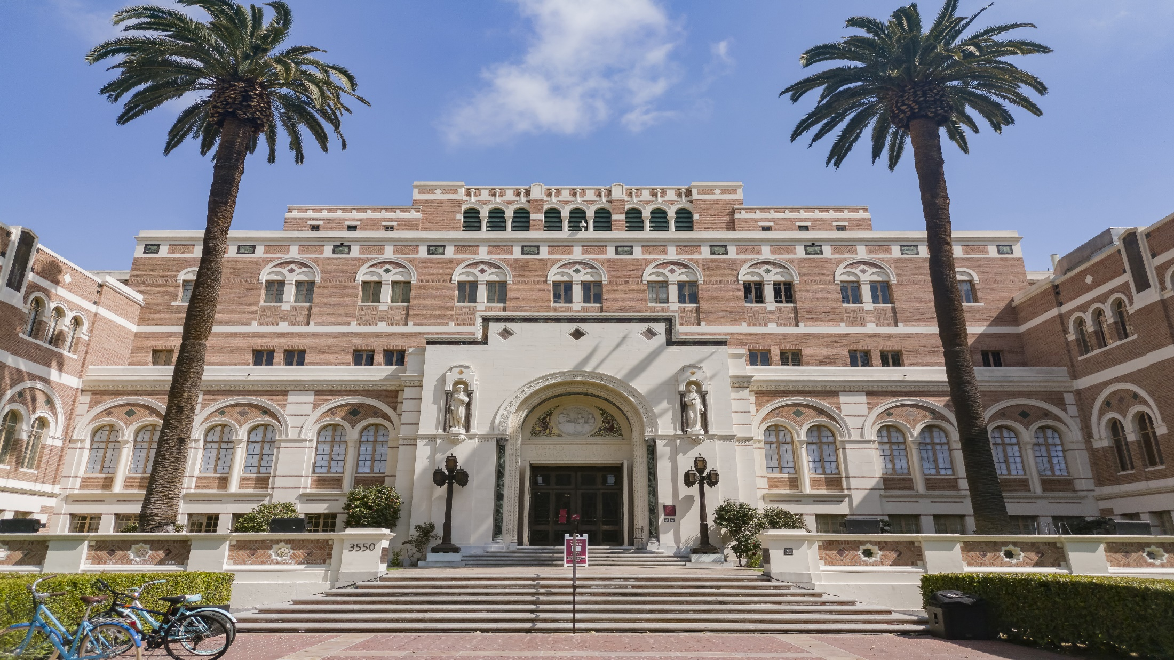
Keck Research admin forum
research services agreements
May 1, 2024

Slide 4
contents
WHAT IS A SERVICES AGREEMENT?
CHARACTERISTICS OF SERVICES?
ROLES AND RESPONSIBILITIES
SERVICES AT PROPOSAL STAGE
SERVICES AT AGREEMENT STAGE
KECK SPECIFIC ROUTING AND APPROVAL
1
2
3
4
5
6

Slide 5
WHAT IS A SERVICES AGREEMENT
USC faculty may perform or oversee service projects under a Service Agreement, in which the services of USC personnel, facilities, or equipment are employed by parties not affiliated with the University. The services are procured by an outside entity for the delivery of specific activities or products with specific desired outcomes. USC personnel execute the work at the buyer’s direction, even if the work being conducted is based on USC expertise, processes, or models.
Most service agreements USC participates in are conducted for public benefit, and the scope of work being conducted aligns with the public service and community outreach missions of USC and the organization receiving the service.
The Principal Investigator should be aware that normally the buyer is the sole benefiter of the work being performed and so may attempt to negotiate terms allowing them to own the work product, and/or restriction of dissemination or publication of results.

Slide 6
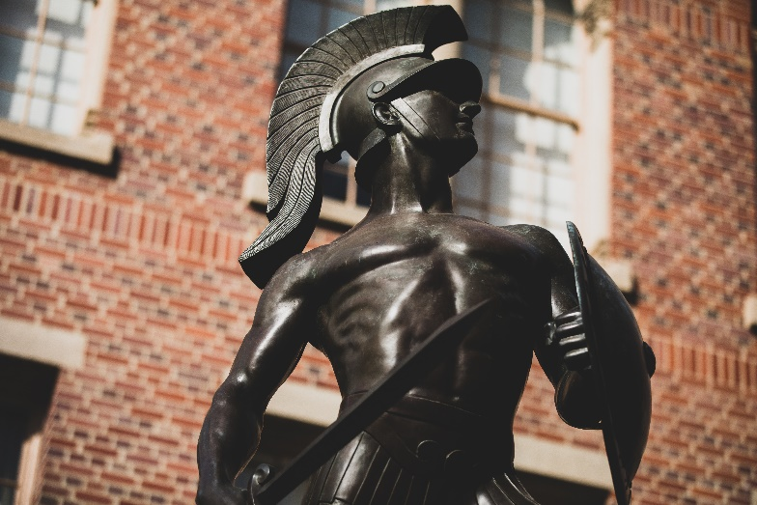
scopes should be classified as services
The delivery of specific activities or products with specific desired outcomes.
Often the work is at the buyer’s direction, even if the work being conducted is based on USC expertise, processes, or models.
While analysis and or data collection might be involved, there should not be significant and novel interpretive analysis on data collected.
Deliverables and results are normally owned by the sponsor.
The work is not expected to result in novel intellectual property.
The primary intent is the performance of services though the work might have indirect academic or research implications outside or that may result.

Slide 7
Other considerations
Does the sponsor view USC’s work as services?
You can often determine the sponsor’s position by reviewing the solicitation, agreement type or the terms of the agreement. You will often see terms such as “Work for Hire” and/or sponsor ownership of deliverables/results. The agreement might reference services or refer to USC’s work as services.
Does the PI view the work as services?
The PI has deep insight into the technical aspects of the scope and can provide insight to the scope of work. Sometimes the scope might not accurately capture the work being performed and so might be misleading. It is often helpful to discuss with the PI to ensure that the designation of services is accurate, and the PI is aware of possible restrictions often associated with a services agreement.

Slide 8
Roles and responsibilities
https://dcg.usc.edu/service-agreements/
Office of General Counsel (OGC)
The OGC in primarily responsible for preparing, reviewing and advising on the legal terms in services agreements.
OGC acts as the authorized signatory that legally binds the University on an services awards.
OGC will coordinate with the appropriate parties at USC to complete their review of the services agreement.
Department/School
Assist the PI with completing and submitting the proposal directly to the sponsor (with the exception of grants.gov proposals which are submitted by DCG).
Work with the central units to ensure the activity type is correctly identified and get appropriate approvals and signatures.
Work with sponsor and OGC to ensure execution of the agreement and route the executed agreement to the appropriate central unit for set up.

Slide 9
Roles and responsibilities
https://dcg.usc.edu/service-agreements/
Department of Contracts and Grants (DCG)
DCG assists with determining that the activity type has been correctly identified (e.g. is the scope of work research, training, fellowship, clinical trial, other or services).
DCG will also handle the submission of services proposal that require submission through grants.gov system. All other proposals will be submitted directly by the PI/Dept.
Upon receipt of fully executed government funded services agreements/amendment and reference the completed Cayuse SP Project Number DCG will set up these awards in Cayuse.
Sponsored Projects Accounting
SPA is responsible for invoicing and financial reporting on services agreements
SPA handles the set up of services agreements in the Workday financial system. Non-government services agreements should be sent directly to SPA for set up in the Workday system.

Slide 10
Roles and responsibilities – points of contact
https://dcg.usc.edu/service-agreements/
Office of General Counsel (OGC)
Vardan Duzdabanyan vduzdaba@usc.edu
Department of Contracts and Grants (DCG)
Katie Rountree Rountree@usc.edu
Sponsored Projects Accounting
SPA Contacts

Slide 11
 | PI | Dept/ School | DCG | OGC | OCEC
Prepare proposal and complete all required docs | P | S
Review and approval of the proposal and proposal budget including F&A amounts | S | P
Questions on how to complete the proposal and/or forms. |  | P
Determination on if the activity type for the scope of work is correctly classified as services. | S | a | P
Review of terms at proposal stage |  | S |  | P
Review of terms at proposal stage relating to USC receipt of ITAR or Export controlled materials and/or receipt of Controlled Defense Information (CDI) or Controlled Unclassified Information (CUI) |  |  |  | S | P
Review and Signature on forms/letters and/or certifications that required USC Authorized signature |  |  |  | P
Submission of the proposal (with the exception of grants.gov proposals) | P | S
Submission of proposals in Grants.Gov (please note that Cayuse SP approvals are required at proposal stage for these proposals) |  |  | P
Responding to any sponsor requests for revisions to the proposal or post submission materials. | P | S
PROPOSAL STAGE: Roles and
responsibilities

Slide 12
Common Proposal stage questions
Is Cayuse SP proposal required prior to proposal submission?
No (for non-grants.gov submissions) Cayuse SP is required at Award stage for services agreements with government funding.
Yes for proposals that require submission through grants.gov please make sure to notify DCG in advance.
Who submits a services proposal?
The PI and or the Department Admin should submit the proposal with the exception of grants.gov submissions which have to be submitted by DCG.
Who should be listed as the point of contact on proposals in Cayuse?
The PI and or the Department Admin should be listed as the POC to ensure that award documents and questions get routed appropriately.
Who should sign forms/certs/letters that require Authorized Official signature?
These should be completed and routed to Vardan Duzdabanyan at OGC to secure Dr. Mark Todd’s signature.

Slide 13
AWARD STAGE: Roles and
responsibilities
 | PI | Dept/ School | DCG | OGC | USC Stevens | OCEC | SPA
Preparation of Cayuse SP approvals for Services Agreements with Government funding (Federal, State, County, City). | P | S
Review/Drafting of terms and conditions | S | S |  | P | a | a
Negotiation of the terms and conditions of the agreement. |  | a | a | P | a | a
Execution of services agreement |  |  |  | P
Set-Up of Non-Government funded services agreements in Workday. | a | a |  |  |  |  | P
Set-Up of Government funded services agreements in Cayuse (upon receipt of executed agreement and complete Cayuse SP) |  | a | P

Slide 14
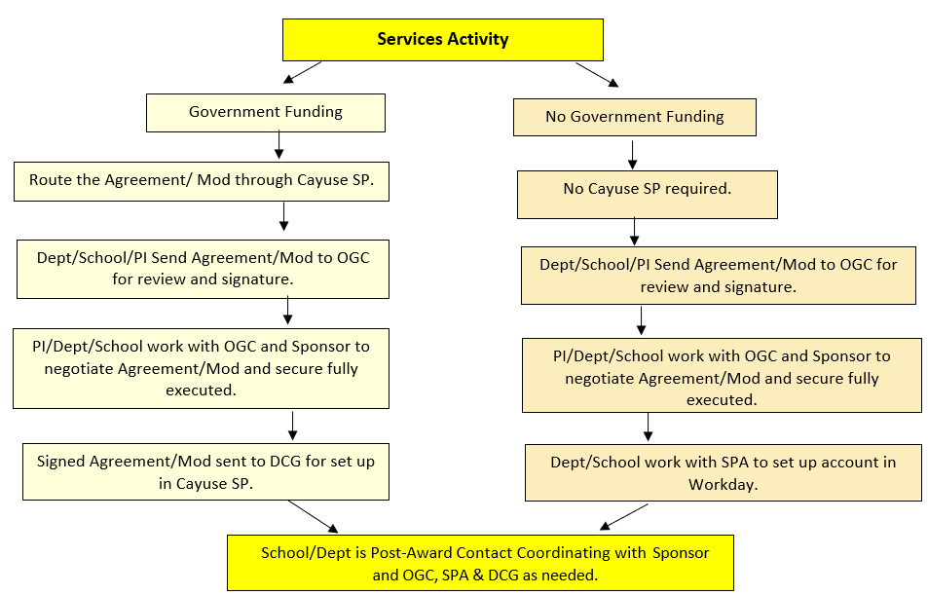
Service agreement
Flow chart

Slide 15
KECK SCHOOL SPECIFIC ROUTING AND APPROVAL
Please complete the KECK Routing and Approval form for all KECK services Agreements and route to KSOM Research Administration for review and approval prior to routing services agreements to OGC for review with the exception of Grants.Gov submissions which will route through Cayuse SP at time of proposal.
Link to Keck form and flow chart: https://keck.usc.edu/office-of-research-administration/policies-and-procedures/

Slide 16
resources
DCG Website: Services Agreements
Keck Services Agreement Approval Form and Flow Chart
USC Offices Responsible for Handling Agreements
Workday Process for Non-Government Services Agreement
Cayuse SP Guide and Training Materials

Slide 17
Communication Is the key!
Office of General Counsel (OGC)
Vardan Duzdabanyan vduzdaba@usc.edu
Department of Contracts and Grants (DCG)
Katie Rountree Rountree@usc.edu
DCG Office Hours via Zoom: https://usc.zoom.us/j/98233041088
Wednesdays: 9-10 a.m.

Slide 18
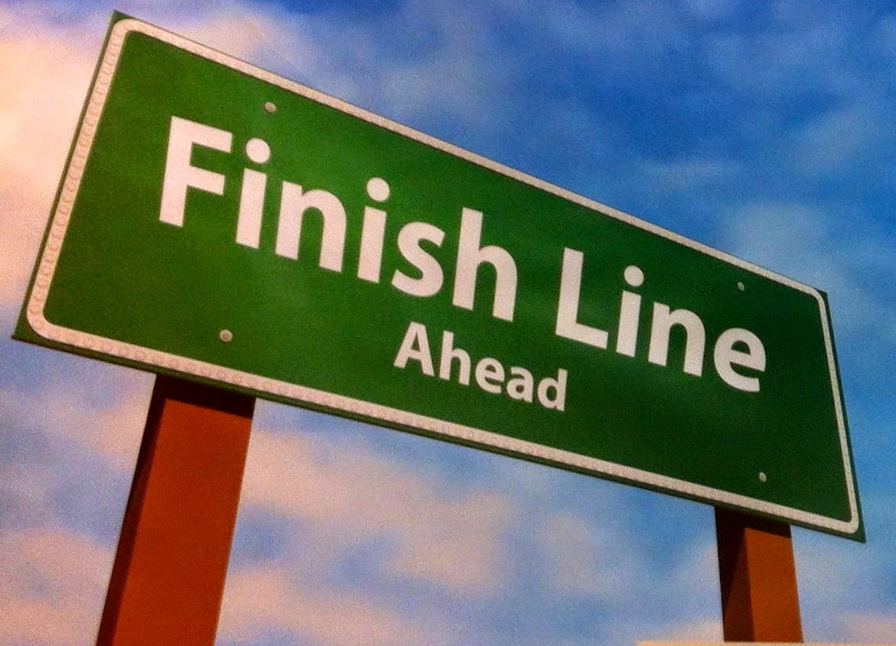
Grant Closeout
This Photo by Unknown Author is licensed under CC BY-NC-ND

Slide 19
Grant Closeout
Impact of incomplete closeout:
Reputational: Public, Scientific Community, Sponsors
Delay of new and continuation awards to USC
Decrease in awards to USC

Slide 20
Grant Closeout
Award Closeout is the process of finalizing all administrative and programmatic requirements for a sponsored award. This includes submitting all required reports, reconciling financial accounts, and returning any unused funds to the funding agency.
Key steps:
Review the award terms and conditions. (PI and Research Administrator)
Submit all required reports: final technical report, final invention statement or a human subject’s research closure report (PI with help from Research Administrator); final financial report (SPA)
Reconcile financial accounts-including cost share accounts. (SPA, Research Administrator, PI)
Close out all Subawards. (Research Administrator, DCG)
Finalize all administrative tasks. (Research Administrator)
Once all of these steps have been completed, the award will be officially closed out. The funding agency will typically issue a notice of award closure, which will release the institution from any further obligations under the award.

Slide 21
Grant Closeout
Key steps involved in Subaward Closeout:
Review the Subaward Agreement. (Research Administrator)
Finalization of all Administrative Tasks. (Research Administrator)
Submission of all Required Reports: final technical report and a final financial report from the Subawardee. (Research Administrator, PI)
Reconcile Financial Accounts. This involves ensuring that all expenses have been properly charged to the Subaward and that all unused funds are returned to the Prime Awardee (USC). (Research Administrator, PI)
Once all of these steps have been completed, the subaward will be officially closed out. PIs are encouraged to remind subrecipients of these needs well in advance of the due date for such reports.

Slide 22
Grant Closeout
Types of Final Reports
Final Technical Report: The Final Technical Report summarizes the project’s accomplishments, findings, and conclusions. It also discusses the project’s impact on the field and any potential future research directions. (PI)
Final Invention Statement: The Final Invention Statement discloses any inventions or discoveries that were made during the project. This information is used by the funding agency to determine whether any intellectual property rights need to be protected. (PI)
Final Property Report: The Final Property Report accounts for all tangible property that was purchased or acquired with funding from the award. (Research Administrator, PI)
Final Subrecipient Reports: If the award included subawards, the institution will also need to submit final reports for each subaward. These reports will typically include the same information as the Final Technical Report, but for the subaward specifically. (Research Administrator)

Slide 23
Grant Closeout
Final reports typically summarize the project’s accomplishments, expenditures, and other relevant information.
Demonstrate Accountability: Final reports allow funding agencies to see how their funds were used and how the research project contributed to the advancement of knowledge.
Provide Feedback: Final reports provide feedback to funding agencies on the strengths and weaknesses of their research programs. This feedback can help funding agencies to improve their programs and make better decisions about how to allocate resources.
Promote Collaboration: Final reports can be shared with other researchers and stakeholders, which can promote collaboration and new discoveries.
Disseminate Research Findings: Final reports can be published and disseminated to the public, which helps to raise awareness of research findings and their potential impact on society.
Final reporting is an important process that helps to ensure the integrity and quality of research. It also helps to promote accountability, collaboration, and the dissemination of research findings.

Slide 24
Grant Closeout
Submitting Final Reports
Typically to the sponsor electronically, through a web-based portal or email. Some sponsors may also accept Final Reports in paper form, but this is less common. To submit a Final Report electronically, the Principal Investigator (PI) will need to log into the sponsor’s web portal and upload the report file. The report file should be in a format that is compatible with the sponsor’s requirements, (such as PDF or Word).
Before submitting the Final Report, it is important to proofread it carefully to ensure that it is complete and accurate. The PI should also check with the sponsor to make sure that the report is in the correct format and that it has been submitted to the correct email address.
All Final Technical Reports, Final Invention Statements, Final Property Reports, and Final Subrecipient Reports should be submitted to the Department of Contracts and Grants (DCG) via the Final Report Submission Portal. Once received, the Award Closeout Team in DCG will internally close out the award in the University’s data system (Cayuse SP).

Slide 25
Grant Closeout Checklist
Best Practices: Checklist Tool
Sample Departmental Grant Closeout Checklist:
https://keck.usc.edu/office-of-research-administration/policies-and-procedures/

Slide 26
Grant Closeout
Sponsor Award Closeout forms
The National Institutes of Health
The National Science Foundation
Department of Defense

Slide 27
Grant Closeout
Resources:
Award Closeout – Department of Contracts and Grants (usc.edu)
Research Lifecycle: Compliance Guidance – Office of Culture, Ethics and Compliance (usc.edu)

Slide 28
Personal COI and Grants
Per USC policy, “A principal investigator shall not permit a person with whom he or she has a family, sexual or other intimate relationship to be paid from the funds of a grant or contract supervised by the principal investigator.” USC Faculty handbook: Section 3-G (b): Personal Conflicts of Interest
Where an individual with whom a principal investigator has a personal conflict of interest, may qualify as essential to a grant/contract proposal and/or award, USC policy allows for an exception process.

Slide 29
Personal COI and Grants
Request for Special Arrangements
In an unusual situation, including but not limited to a prior existing family or other relationship, that would otherwise call for a faculty member to supervise or evaluate the work of someone with whom the faculty member has such a relationship, the faculty member is required to disclose the relationship to the dean (or the dean’s designee), and may continue to supervise or evaluate only if, at the request of both parties, special arrangements are approved by the dean (or the dean’s designee) to avoid the possibility of favoritism, such as having an unrelated third party supervise or evaluate the work. The Provost’s written permission is also required. The faculty member may appeal the dean’s decision to the Provost.

Slide 30
Personal COI and Grants
KSOM Exception Process and Management Plan
Submit a letter from the Department Chair to the KSOM Vice Dean of Research, Dr. Tom Buchanan, requesting the exception. (cc: Janet Stoeckert, Marie Choi)
Include:
a. PI name and individual with whom the PI has a personal conflict of interest.
b. Justification for exception based on grant scope of work and expertise needed.
c. Describe the special arrangements for supervision or management plan to avoid possibility of favoritism or bias, and compromise of research integrity.
d. Describe commitment to monitoring of management plan
The plan will be reviewed by the Vice Dean of Research and the Dean. If approved, Provost approval will be requested.
Allow three weeks for review and approval by the Dean, Vice Dean and Provost.

Slide 31
Thank you!

