Slide 1
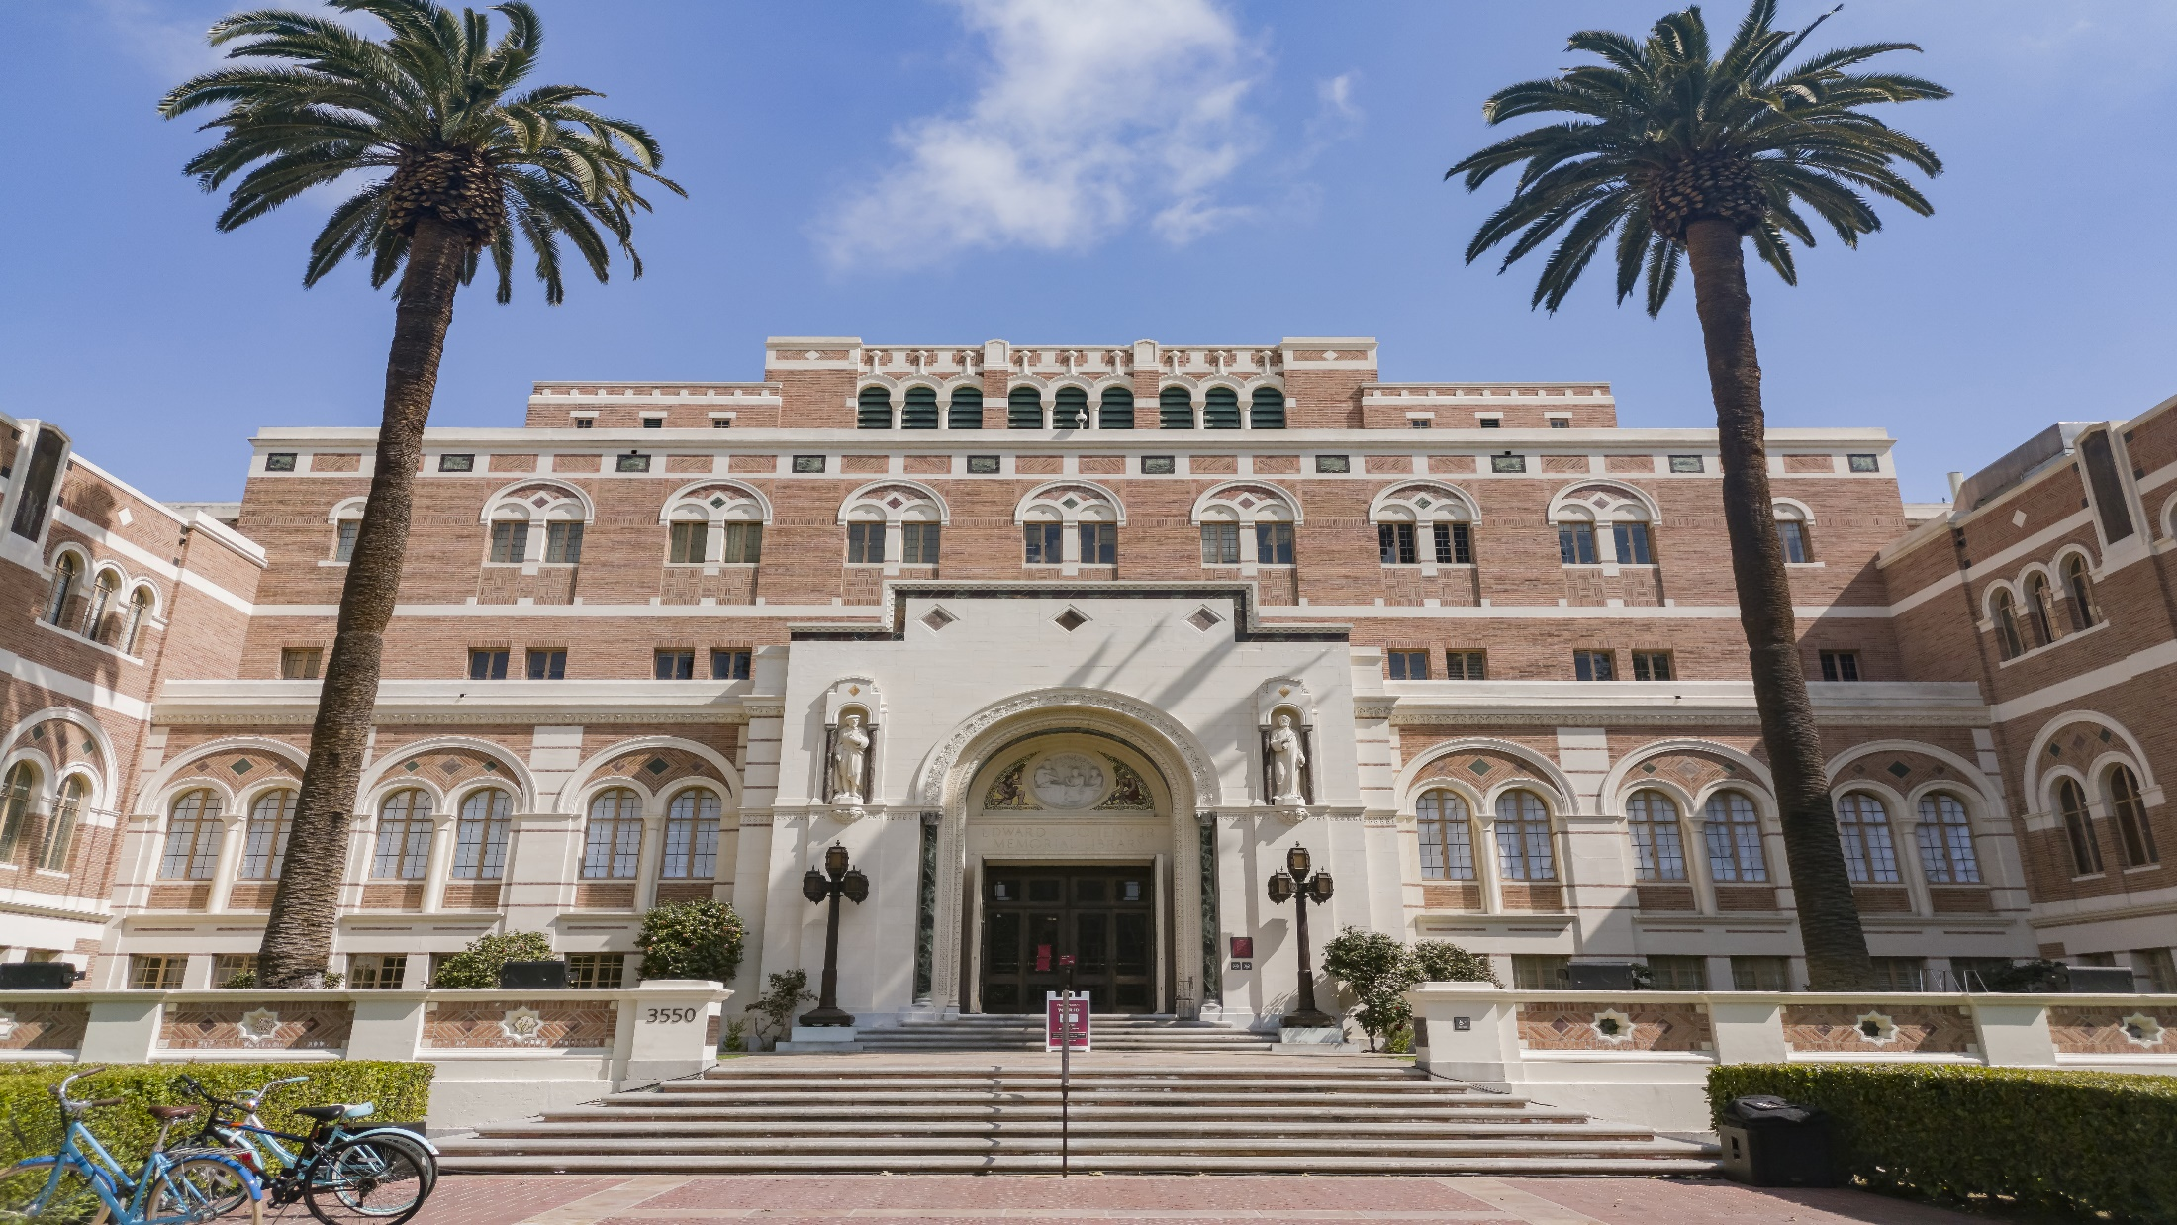
UPDATES IN RESEARCH ADMINISTRATION Dec 5, 2024

Slide 2
Intoductions
Katie Rountree
Department of Contracts and Grants
Associate Director
Andres Chan
Office of Financial Analysis
Director
Emily Pender
Office of Culture, Ethics and Compliance
Assistant Director
Notes:
Katie Slide

Slide 3
CONTENTS
REVIEW SOME RECENT CHANGES TO 2CFR200
FEDERAL CONTRACTOR INFORMATION
QUESTIONS
Notes:
KAtie Slide

Slide 4
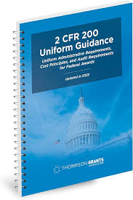
2CFR200
What is 2CFR200
2 CFR 200, also known as the Uniform Guidance, is a set of regulations that governs the administration of federal awards to state and local governments, universities, and non-profit organizations. It provides a framework for consistent grant management practices, including cost principles, audit requirements, and standards for procurement.
When did the updates take effect
Updates were made to the new 2CFR200 with was release 10/1 and are applicable to awards issued on or after 10/1. With the exception of Subpart F applicable to fiscal years after 10/1 as this relates to audits.
Notes:
Katie Slide

Slide 5
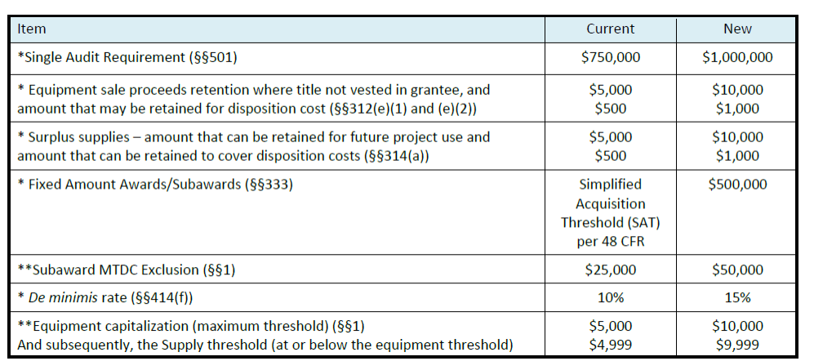
CHANGES TO LIMITS & THRESHOLDS
*Implement on awards issued or revised on October 1, 2024, and beyond.
**Implement with your negotiated F&A cost rate
Notes:
Andres Chan

Slide 6
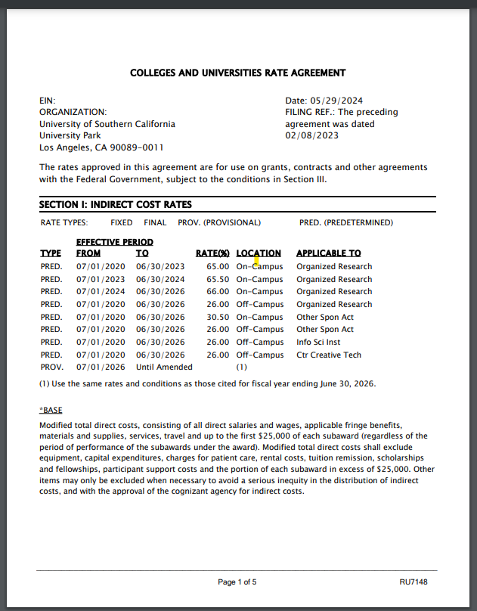
Our Current Rate Agreement
https://dcg.usc.edu/proposal-rates-at-a-glance/
Our currently negotiated rate agreement MTDC base:
Equipment is currently set at $5,000
Subawards are only charged overhead on the first $25,000
When does our rate agreement expire?
Currently our rate agreement expires 6/30/2026
Will these updated rates be included in our new rate agreement?
Notes:
Andres Chan

Slide 7
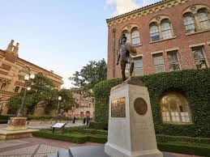
Termination Costs - Vacation Balances
What changes have been made to the language?
Section 200.341 governing Fringe Benefits language has been added to clarify that unused leave when an employee retires or terminates need to be charged as general administrative expense or included in the fringe rate.
What is the result of this change?
As a result of this change unused leave when an employee retires or terminates cannot be charged to the grant as a direct expense and must be charged to a unrestricted PPG.
How is USC addressing this change?
The expenses for unused leave at time of termination or
retirement will need to be absorbed in accordance with
School policy. Given the unanticipated nature of this
significant financial change, and current financial constraints
and headwinds – KSOM will expect that unused vacation time
will be the financial responsibility of the PI’s
Department/Institute/Center.
Notes:
Andres Chan slide

Slide 8
Updates To Subawards
Topic | Change | Impact
SAMS Registration | Full registration in SAM’s is needed to receive federal contract funds. | Please check early so SAM registration can be in place at time of award.
Fixed Price Subawards | Increase in amount to $500K. Subs must confirm in writing that they have completed all milestones. | Prior approval is still required. PI will need to ensure that they have required written certification that all work was performed.
Higher Risk Subawards | Required to notify the sponsor of higher risk Subawards and provide specific conditions that will be added to address risk. | DCG will work with schools and PIs to notify and identify high risk subs, notify the sponsor and recommend terms to mitigate.
De Minimis Rate | Lifted to an amount not to exceed 15% | Where applicable this can be utilized.
Subaward Certs | written certification required from subs that the accuracy of their proposals, invoices, and financial reports | The USC Sub cert form and invoice templates have been updated to include the new language.
Notes:
Katie Slides

Slide 9
Questions about 2CFR200 ?
DCG Contacts:
DCG Contact Directory DCG Office Hours via Zoom: Wednesdays: 9-10 a.m.
Office of Financial Analysis:
Andres Chan
andres.chan@usc.edu
Notes:
Katie and Andres

Slide 10
Federal Contract Information
What is Federal Contract Information?
Federal contract information (FCI) means information, not intended for public release, that is provided by or generated for the Government under a contract to develop or deliver a product or service to the Government, but not including information provided by the Government to the public (such as on public websites) or simple transactional information, such as necessary to process payments.
When do I need to be concerned about Federal Contractor Information?
If the following FAR clause is present in the award: 52.204-21 Basic Safeguarding of Covered Contractor Information Systems.
Notes:
Emily Pender

Slide 11
Understanding Controlled Data Types
Federal Contract Information is the lowest level of controlled data which requires the application of security requirements when processed, stored or transmitted as it is not intended for public release.
Least Sensitive
Public Information
Federal Contract Information (FCI) | Information, not intended for public release, that is provided by or generated for the Government under a contract to develop or deliver a product or service to the Government, but not including information provided by the Government to the public (such as that on public Web sites) or simple transactional information, such as that necessary to process payments.
Controlled Unclassified Information (CUI)* | Information that requires safeguarding or dissemination controls pursuant to and consistent with applicable law, regulations, and government-wide policies but is not classified under Executive Order 13526 or the Atomic Energy Act, as amended.
Confidential / Secret / Top Secret | Information that has been determined to require protection against unauthorized disclosure and is marked to indicate its classified status when in documentary form. Unauthorized disclosure could reasonably be expected to cause varying degrees of damage to national security.
All CUI is FCI, but not vice versa
Most Sensitive
Note: Covered Defense Information (CDI) is a subset of CUI
Notes:
CUI Definition: 252.204-7012 Safeguarding Covered Defense Information and Cyber Incident Reporting. | Acquisition.GOV
FCI Definition: 4.1901 Definitions. | Acquisition.GOV

Slide 12
Significance of FAR 52.204-21
What is so impactful about this FAR clause?
IT security controls can be burdensome when they apply (e.g., clause requires compliance with 15 basic security safeguards for handling FCI).
We are seeing increased Government scrutiny around cybersecurity protections for federally funded research (both basic research and restricted research).
Why is this so important now?
Effort underway to heighten research data protections and provide tools/knowledge to USC community.
Goal: continue to meet security requirements and obtain research grants.
High likelihood of expanded use of these clauses by federal sponsors.
Notes:
Emily Pender

Slide 13
Identifying FCI
Because of the lack of defined categories and broad applicability, FCI may be most easily identified by confirming that it does not fall into other categories.
Documents marked “Not for Public Release” constitute FCI unless supplemental marking are present
Treat information based on label present
(CUI, Secret, etc.)
Yes
Data received
Is Information labelled as CUI or higher sensitivity?
Public Data
No
Yes
Is the information public?
No
FCI

Slide 14
Compliance with 52.204-21
When do I need to be in compliance with this provision?
If the sponsor has included the provision and will not include a statement that no federal contract information will be provided, then you may receive such information and so need to work with your local IT to confirm that you are in compliance.
How do I provide confirmation of compliance with this FAR provision?
You will need to work with your local IT resource to get written confirmation that computer systems are in compliance with the requirements of this provision. Once written permission is obtained, you will provide it to your DCG Officer so that they can accept the provision.
Notes:
Emily PEnder

Slide 15
Questions about Federal Contractor Information ?
Office of Culture, Ethics and Compliance:
Emily Pender
Assistant Director, Export Control Compliance
epender@usc.edu
DCG Contacts:
DCG Contact Directory DCG Office Hours via Zoom: Wednesdays: 9-10 a.m.
Notes:
KAtie and Emily

